Slide 1

Analyzing COVID-19 Data in South Korea
Alex Petrallo

Slide 2
Background and Interest
In the past six months the novel corona virus pandemic has affected most every country in the world. Several countries have dealt with the problem in different ways, but South Korea is viewed as the most successful. South Korea was able to ‘flatten the curve’ of cases without shutting down major business or having as strict lockdown measures as other wealthy nations.
By analyzing the COVID-19 data we can gain some insight to as to how South Korea was able to be successful in handling the pandemic.
The insights that I will be uncovering in this data will be useful for future epidemics were leaders will attempt to minimize the spread. This is information will also be good for the individual to better understand how they can protect themselves during a pandemic.

Slide 3
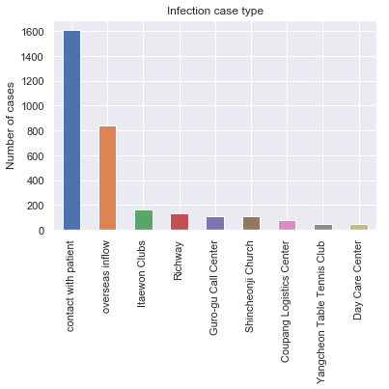
Exploratory Data Analysis
The analysis of this disease should start with how the Corona virus has been transmitted in Korea. This chart shows how many of each type of infection case have occurred. The most common way this disease was spread was via direct contact with a known patient.

Slide 4
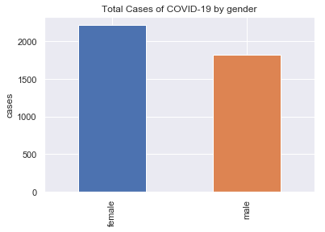
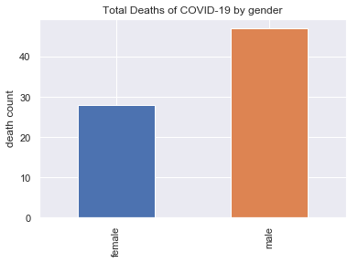
Data on Sex of Patients
Some interesting stats I found on the sex and gender of patients is that although men were less likely to contract COVID-19, it was much more likely to be fatal for them. Women were 1.2 times as likely to contract the virus and men were 1.7 times are likely to die if they contracted the virus. The fatality rate in women is 0.0126% and in men is 0.0257%. These charts show this data represented in bar graphs so you see the relation between the genders.

Slide 5
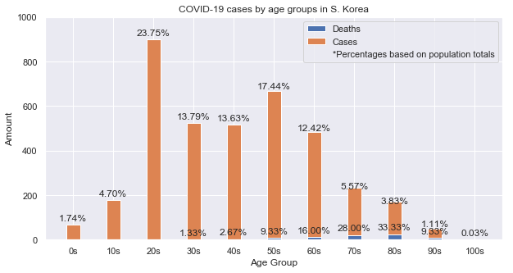
Data on Age of Patient
I did an initial plot to see how many people from each group contracted the virus. The chart shows the highest number of cases were in the 20s-50s age group. This makes sense as these would be the groups to be most active and involved in things outside, whereas older people and young children may have an easier time staying home. Although the 70+ age groups were some of the lowest groups to contract the virus, they were the most likely to pass due to contraction. Although making only 3.83% of total cases, the 80s age group had a third of all deaths. The death rate for people in their 80s is 0.147%.

Slide 6
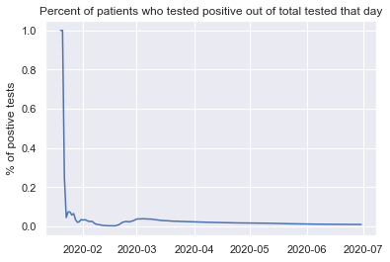
Plotting ratios (part i/iii)
I decided to plot the ratio between positive and total tests administered that day. I feel that this can help show that although there are a lot more cases, testing has increased and would therefore affect these numbers. It is also important to consider that the breadth of testing also could mean over-testing or just testing a lot of negative people for cautionary reasons. In the early part of the pandemic, mostly people who were showing the need for the test were taken care of in this way.

Slide 7
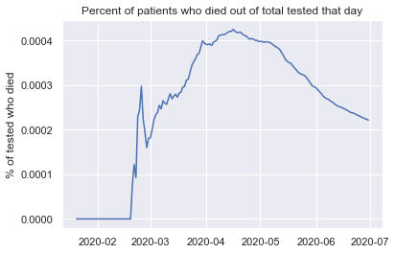
Plotting ratios (part ii/iii)
This chart can help show the necessity of test by showing the relationship of positive test and death tolls. The plot shows the percentage of COVID-19 deaths out of total tests that day.

Slide 8
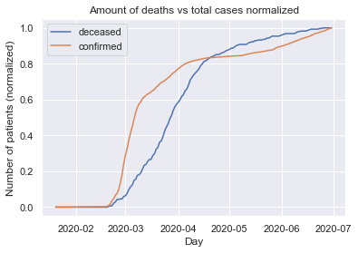
Plotting ratios (part iii/iii)
Another interesting ratio I found was the relationship between death and total cases that day. I normalized the data so that a comparison can be made and at times the rates of change are different even though you'd expect them to be pretty similar. The plot shows that the growth of total deaths starts slower than total cases does early on. However, later on death tolls grow faster than the cases do.

Slide 9
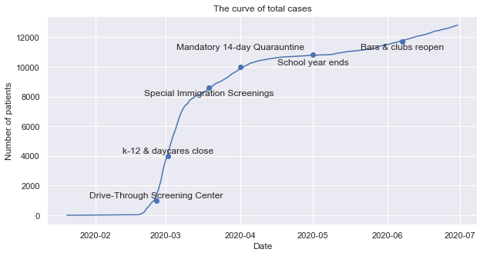
The Curve
This plot shows a plot of the total COVID-19 cases in Korea up to June 27th. I also added some annotated points on the curve that indicate days when certain policies were put in place to foster a discussion on how policy affected the curve. One of the more notable points is the Mandatory 14 Day Quarantine that started on April 1. The curve seems to flatten by the end of the month for a little bit. This could also be an impact of the Special Immigration Screenings coming from all countries two weeks prior. There also seems to be a steady trend of increased cases after school gets out which may be a social indicator for people to visit each other more or just the start of summertime lead people to be more social. Finally, when the bars and clubs open again, the already increasing slope of the curve, it just makes it worse it seems.

Slide 10
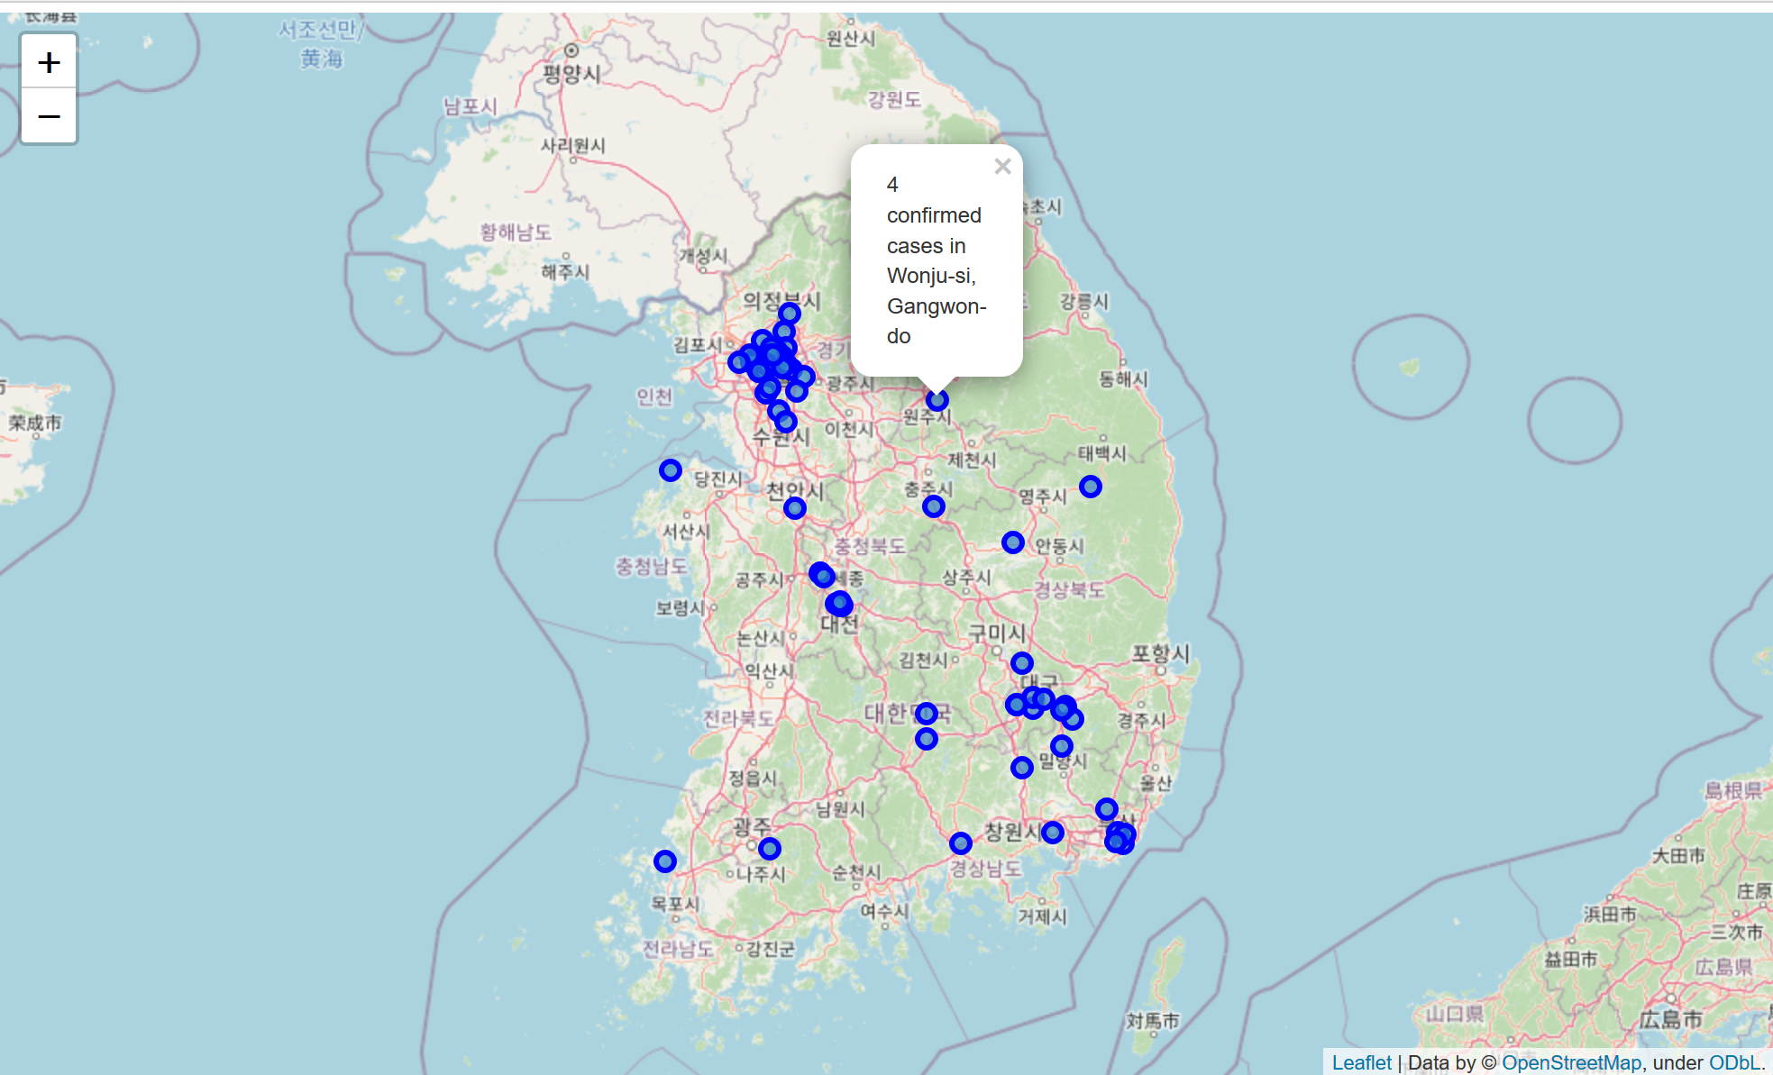
Map
Here’s a map with markers for cases in each city. Upon clicking a marker you can get the information about the cases and the city.

